Slide 1
Kanban Overview

Slide 2

Logistics
Notes:
10 minutes (2 slides)
Safety – Hotel Representative to cover site safety information (cover: Incase of emergency, restrooms, medical information, known drills for the day)
Iterations – We have a lot of material to cover and our plan is to cover ~60 minutes and then take a break. Please respect the time of the break. We will promptly start up at the end of the period allocated for break.

Slide 3

Tanes Jedsadawaranon (Tim)
Tanes Jedsadawaranon (Tim)
http://goto/timfrombangkok
Married last year
Work history
2007 – 2015: SAP Programming Services (HR, DS, E&D)
2015 – present: Agile Support Center (Expat to the US)
Hobbies
Drumming, board gaming, puzzles & music

Slide 4
Revision History
Version | Date | Reason | Changed By
1.0 | 5/8/15 | Original Creation | Tanes
1.1 | 5/11/15 | Reviewed / Copy Edit | Bryan
2.0 | 5/18/15 | Updated with feedback from Na; Added distinction between principles and practices; Added burger animations | Tanes
2.1 | 5/19/15 | Feedback from PAS training | Tanes / Bryan
2.2 | 5/20/15 | Slow down + add work in progress in burger process | Tanes
2.3 | 7/20/15 | Added infrastructure example (hidden by default) | Bryan
2.4 | 9/15/15 | Added additional notes | Tanes
2.5 | 10/19/15 | Updated the TFS info in the Appendix + minor clean ups | Bryan
2.6 | 11/16/15 | Update with “Project” related info | Bryan
3.0 | 6/28/16 | Move Kanban value slide up before practices Remove some slides in Visualize Workflow part Remove Kanban vs. Task board Add Kanban value slide Replace Burger example with why WIP limit Add Kanban critial practices slides Revamp Class of Service, Metrics Align Retrospective slides from other decks | Tanes

Slide 5
Revision History
Version | Date | Reason | Changed By
4.0 | 2/8/2017 | Move to the new template | Tanes
4.1 | 6/14/2017 | Update to horseshoe slide Revise course objectives | Tanes

Slide 6
Expectation Setting
With Agile there is no cookie cutter process that can be applied to all situations
The recommendations in this deck are not a checklist
For best results an experienced coach should work with the team to tailor the process to their particular needs

Slide 7
Learning Objectives
Can distinguish the difference between Kanban boards & the Kanban framework
Can articulate the effect of having high WIP
Can demonstrate how Kanban framework can help the team manage WIP\
What you might not get from this presentation
Step-by-step how to set up the Kanban framework for your team
Details of tools for Kanban

Slide 8

Kanban – David J. Anderson
Notes:
Objective:
Our content is mainly from this book
Kanban is an Agile framework that is in the market for a while (2007)
Content based on this guy David J Anderson who started to use Kanban method in software development and came up with this book five years ago. He is called a father of Kanban.
He had 5 properties of Kanban in this book and later expanded to 4 principles & 6 practices instead
http://www.djaa.com/principles-general-practices-kanban-method
In the book, Kanban - Successful Evolutionary Change for your Technology Business, I identified what I called the "5 core properties" that I’d observed to be present in each successful implementation of Kanban.
Since the book was published we've expanded this list and they are now known as the Principles and General Practices of Kanban.

Slide 9
Why Kanban?

Slide 10
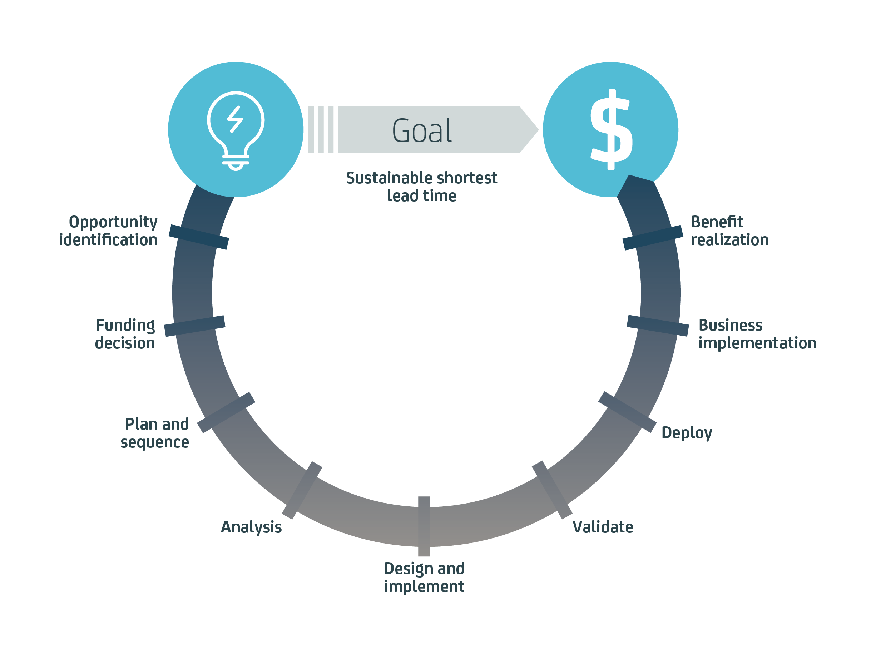

The Goal: Sustainable Shortest Lead Time
Notes:
Ideas to value, concept to cash
Explain each process step
How long does it take today?
Why do we need to be fast? -> Next slide

Slide 11
Value
Right Thing
Right
Way
Accelerate delivery of value to customers
Speed
Notes:
Objectives:
The goal is not agile. The goal is to accelerate the delivery of value to our customers.
Agile is not about the speed (Example – Team that delivers fast, but break production, Highlight the word “Delivery of Value”)
Value comes from building the right thing / building the thing right
Agile is a combination of those three
Speed – Scrum, Kanban, MVP
- Speed of value delivery, not project completion
- Agile does not guarantee that it will complete earlier (because it is relative to initial estimate, where it could be wrong) however, Agile will let us know earlier that it will happen
Right Thing – UCD, Prioritization, MVP, User Story
- Right thing at the right time
- Right thing = Things that provide customers value
Right Way – Engineering, architecture
- Testing automation
- Product should not create technical debt (DART)
Confirm audience that this is the right Why
Tim’s Script:
Whenever we think about Agile, we think about speed <1>. Agile means fast, right? We want to get things done faster, deliver to our customers faster which sound good but is that what Agile? Let me give you an example.
We had a team which they called themselves the Agile team. They adopted Scrum framework and do 2-week iteration. They follow the framework, have all the ceremonies and even better, they were able to deploy changes to the production every two weeks. Sounds cool right. However, we went back to customers and they were totally unsatisfied with what this team provided. Why? And they said, you know what, whatever changes that they made to the production, they did not really work for us. They are partially done like the team just wants to ship it and even worse, they broke something in the production because of those changes. Since changes reach the production too often, now we do not really trust the system as something might not work today.
We went back to the team and ask why they did this and they said, you know what, that is Agile. We follow the Agile framework and Agile said that we should deliver changes to the production frequently so we have to drop something to compensate with speed. We reduced the testing time and if it breaks something in the production, we will fix it fast because we are Agile.
If you were customers, do you want this team to support your application? Definitely, no. Is this Agile? Totally not. This is a very good example on people who blithely follow “How” without understanding the “Why”. The team focused only the speed but one thing that they totally miss is the part of value <2>. We do not want to just deliver solution fast, we want to deliver value fast.
Now, what does it mean by value? Customers expect to earn some benefits out of our IT solution, right? The first thing is to make sure that we build the right thing <3> for our customers. The right thing does not mean that we build the thing that they asked for, but we build the thing that they actually need. Sometimes, it is pretty hard for our customers to know what they need and that’s why in Agile, we tend to show the product in the early stage to help customers figure out the right things for themselves.
Another side of value is to build the product “the right way”. In agile space, we have a lot of technical practices that helps improve the product quality in a long run, for an example test-driven development which automate the regression testing at the unit level & detect issue at the early stage.
With all three aspects, that is why we do Agile. The end goal of adopting Agile is to accelerate delivery of value to customers. It does not matter on what you do or how you do it.
Back to the story of that team, if they focus more on the Agile goal, they will not ship the unfinished product to the production, have a transparency with what they are doing and make sure that customers will make a call on what will be delivered. With this, we can ensure that we can achieve the Agile goal.
Bryan’s script:
Speed + Right Thing, but w/o Right Way = A product with a large amount of technical debt that will be hard to change
Right Thing + Right Way, but w/o Speed = The right product and easy to support, but delivered too late
Right Way + Speed, but w/o Right Thing = The “Taj Mahal” delivered quickly, but not what the business wanted
None of those is what we want so we need to make sure to include all three to achieve our goal

Slide 12
Common problems in teams
Transparency
Who is doing what
EMIT is a black box
Priority
Busy with low priority work
Collaboration
Task driven
Silos
Don’t see Big Picture
Not empowered / motivated
Focus
Multitasking
Start work but not finish it
Squeaky wheel
Improvement
Team goal
Lack of metrics
Unaligned across the team
Notes:
ASC has been working with many teams and they all share the same problems. Ask audience which problems resonate their situation
Transparency
Do not know who is doing what
Customers feel like EMIT is so slow while we are very busy
The team does not see what is going on in the team
Priority
People work on tasks those they are assigned to.
Squeaky wheels – Work on the one makes the noise first (mean work on the items those are being followed up first, rather than focusing on the real priority)
Team is not aligned in priority – E.g., one person thinks that his item has higher priority so he does not help another person, who actually owns higher priority item
Collaboration
People work from the queue so they lose sight of having a team and they become task-driven
Individual silo – people work on their own queue
They feel like they are working alone and it demotivates people
Multitasking
We have a lot of work coming at the same time, then it causes us to multitask. When we multitask, we lose around 20% of our productivity due to context switching.
We keep starting the new work to make some progress while we do not really finish it.
Improvement
Most teams do not have a goal. Without goal, people are lost in directions and they focus their own work instead of team’s work
Most teams do not have metrics to measure team performance. That makes people fee like our team is good already. No need to improve

Slide 13
Kanban Success Stories in EM

Slide 14
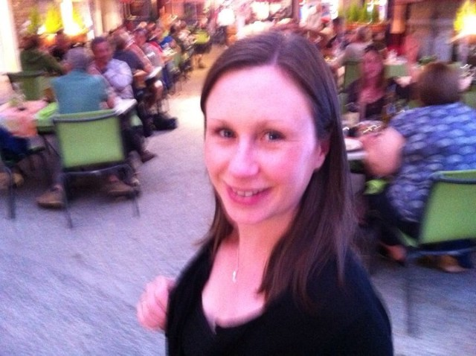

Kanban helped us reduce our backlog of aging tickets by 86%
Our backlog of tickets reduced from 150 down to 27 in 7 months
Katie Tuck
M&S Quality Management Supervisor
Daniel Mateos
M&S Process Monitoring Supervisor

Slide 15

Average Lead time decreased from 8.8 days to 4.3 days per ticket
Thanyathorn Patanaanunwong (Pom)
Sales & Marketing – Retail Run Team

Slide 16
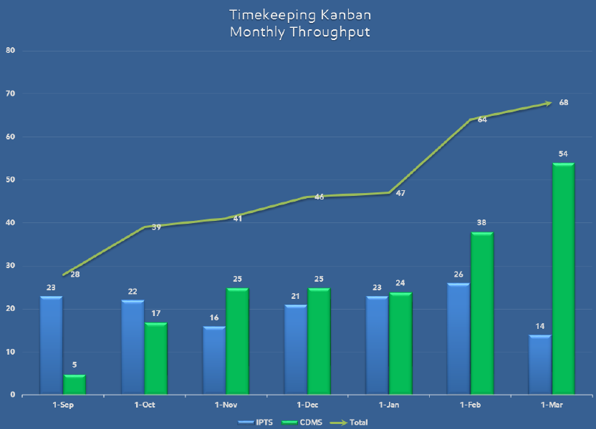

We have increased our monthly throughput by 143% and reduced our average cycle times to 6 days
Richard Eckhart
M&S Time Keeping & Manufacturing
Notes:
Richard Eckhart

Slide 17
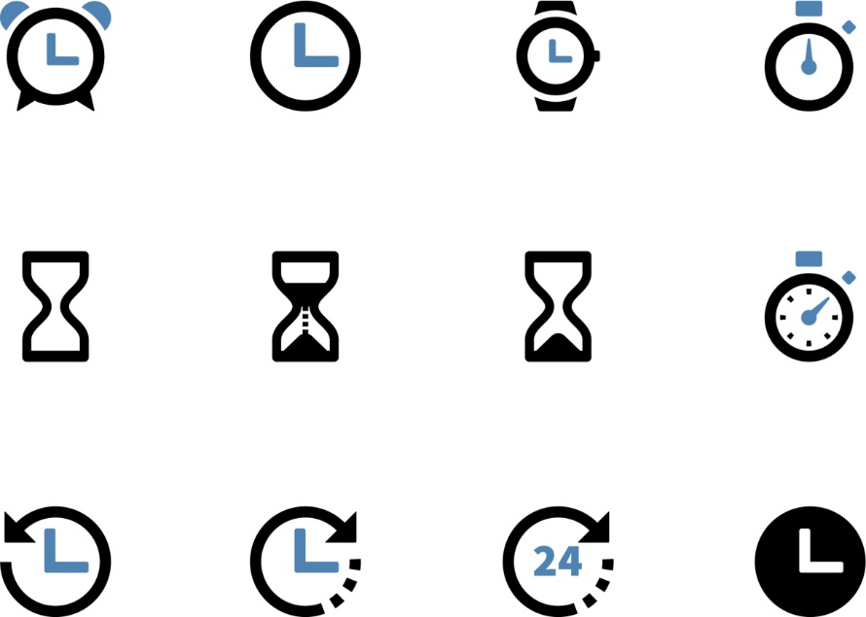

Lead time
Waiting time for customers
Throughput
Requests done per period
Up to 50%
Lead time decrease seen after 6 months of implementation
Up to 143% Throughput Increase seen by other EMIT teams converting to Kanban

Slide 18
What is Kanban?

Slide 19
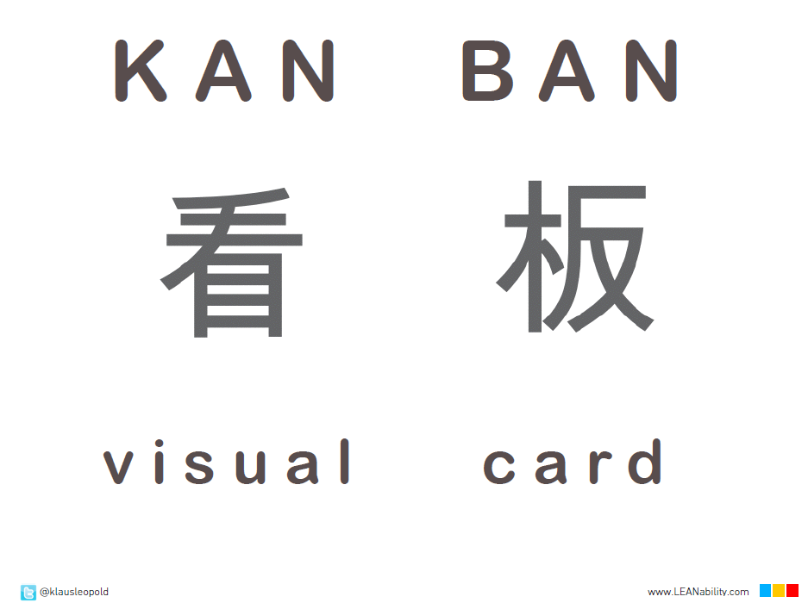
Notes:
Kanban is a Japanese word which literally means - Visual Card / Signal card
This card is firstly used in Toyota manufacturing process to inform upstream process to produce more. The upstream process is not allowed to do work unless they are signaled from the downstream step to do so.
Small market share -> Better way of working
Just-in-time manufacturing – Signal to refill their stock
Example: (I will make a slide later)
Process A -> Process B -> Process C
Process A can make 100 pieces/day to supply process B
Process B can process 10 pieces/day.
At the end of the day, we will have 100 – 10 = 90 of A products which cannot be used. Then we have to pay for the storage.
Instead of letting A work at their maximum capacity, we should allow A to produce less, just enough to keep substream B busy. Then A has more availability to do something else. To do that, B has to give a signal to process A whenever their stock starts to deplete by giving a card to process A. (Please refer story with Bryan as he reads the book. I heard this from other folks so it might not be exactly what it is)
This is a pull concept which we will talk more later.

Slide 20
Kanban Board
New
Design
Develop
Test
Done
Work 4
Work 3
Work 2
Work 1
Work 7
Work 5
Work 6
Notes:
Objective
Showing how Kanban board looks like quickly
Kanban board = show status of each work item
Process (New to Done) Work item status is shown in a column header

Slide 21
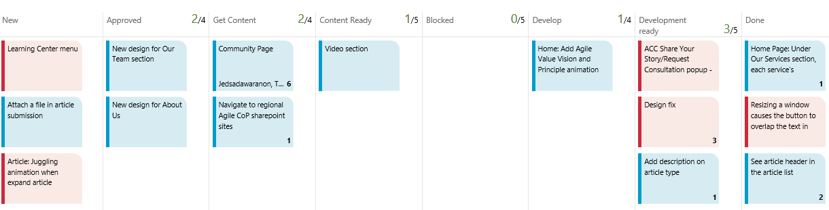
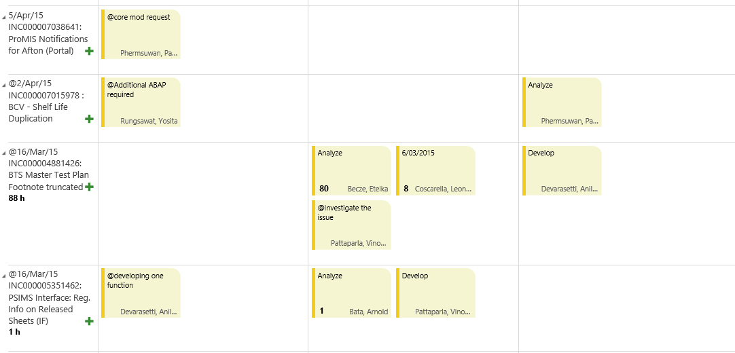
Kanban Board vs. Task Board
Notes:
Objective
This explains the difference between Kanban board & Scrum task board. Kanban has configurable columns & the column shows the status of the items while task board shows the status of tasks, not the work item
Kanban board uses columns to determine the current status of each item while Task board has each item in a swim lane and have tasks broken down in its own row. Each task shows its status on the board
Difference
You immediately recognize work item status from the column while task board, you need to write the task first
Task board has 3 columns fixed while Kanban columns are flexible, up to you process.

Slide 22
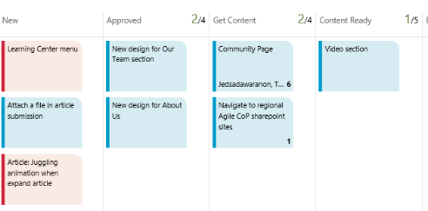

Kanban Board vs. Kanban Framework
Kanban Board
Kanban Framework
Notes:
Objective
When we talk about Kanban, people often understand it as a Kanban Board while having just a board is not a framework. Kanban Framework requires to have a board + 4 practices & 6 principles

Slide 23
Visualization
Collaboration
Commitment
Prioritization
Efficiency
Evolution
Kanban Evolution
Kanban Framework
Kanban Board
Notes:
Objective: Kanban is NOT about visualization. It is about continuous improvement
Benefits = where you set the goal. If you set the goal at prioritization, that is what you get.
Implementing Kanban board gives us these benefits
Visualization
Discover information those are hardly seen (bottle necks, aged items, workload)
Align team’s understanding
Prioritization
Make sure that team always deliver the highest value items from customer perspective
Most of the team those applied Kanban always earn these benefits. However, if we step beyond just a Kanban board, but Kanban framework, then we get even more benefits.
Collaboration
Visualized blockers help people to break silos and help each other to get things done
Efficiency
WIP limit helps the team to focus on a fewer number of items and get it done faster with less efficiency loss due to multi-tasking
Pull concept also helps on focus
Commitment
Metrics & goals drive commitment to the team, changing mindset from task-oriented to result / value oriented
Evolution
The team agrees to improve and evolve

Slide 24
Kanban Framework
Kanban Framework is an Agile work management framework
Kanban Framework = Kanban Board + Kanban Principles + Kanban Practices
Flow-based
Flexible & lightweight
Change the Kanban Board to fit your process
Notes:
Flow-based = Pull items whenever the team is ready vs Iterative based where you can pull items only at the beginning of the iteration

Slide 25
Kanban Framework – Key benefits
Customer engagement in work selection
Visualization
Discover information that is hard to see (bottle necks, aged items, workload)
Reduce lead time while increase throughput
Focus more on getting rid of blockers
Reduce multi-tasking
Continuous improvement process
Measurement and Analysis

Slide 26
Kanban Framework – Key benefits for projects
Visualization
Discover information that is hard to see (bottle necks, aged items, workload)
Reduce lead time while increase throughput
Focus more on getting rid of blockers
Reduce multi-tasking
Continuous improvement process
Measurement and Analysis
Notes:
[Project slide]

Slide 27
Kanban Principles

Slide 28
Kanban Principles
Start with what you do now
Encourage acts of leadership at all levels in your organization
Agree to pursue incremental, evolutionary change
Respect the current process, roles, responsibilities & titles
Notes:
Start with what you do now The Kanban Method does not ask you to change your process. It is based on the concept that you evolve your current process. There is no sweeping, engineered change to a new process definition or style of working. There is no such thing as the Kanban Software Development Process or the Kanban Project Management Method.
Agree to pursue incremental, evolutionary change The organization (or team) must agree that their current circumstances warrant a gentle, evolutionary approach to improvement. Perhaps a sweeping engineered change has recently failed due to resistance from team members, or perhaps the politics of the organization make it too risky for managers to propose and implement sweeping changes? Without agreement that a slow, gentle, evolutionary, incremental approach is the right way forward then there won’t be the right environment or management support for a Kanban initiative.
Respect the current process, roles, responsibilities and job titles It is likely that, what the organization currently does, has some elements that work acceptably and are worth preserving. We must also seek to drive out fear in order to facilitate future change. By agreeing to respect current roles, responsibilities and job titles we eliminate initial fears. This should enable us to gain broader support for our Kanban initiative. Perhaps presenting Kanban against an alternative more sweeping approach that would lead to changes in titles, roles, responsibilities and perhaps the wholesale removal of certain positions will help individuals to realize the benefits.
Encourage acts of leadership at all levels in the your organization Without leadership to catalyze change things will not improve. Information about where improvements are possible can appear at any level in an organization and most often at the individual contributor level. If changes are to be made quickly and effectively individuals who believe improvement is possible must feel empowered to enact it. A culture of safety, must exist, to take action without fear of retribution providing changes can be defended based on logical explanation using models and data.

Slide 29
Kanban Practices

Slide 30
Kanban Practices
Kanban Practices
Visualize Workflow
Limit Work-in-progress
Manage flow
Make policies explicit
Improve Collaboratively Explore
Experimentally
Implement feedback loop

Slide 31
Kanban Practices
Kanban Practices
Visualize Workflow
Limit Work-in-progress
Manage flow
Make policies explicit
Improve Collaboratively Explore
Experimentally
Implement feedback loop

Slide 32
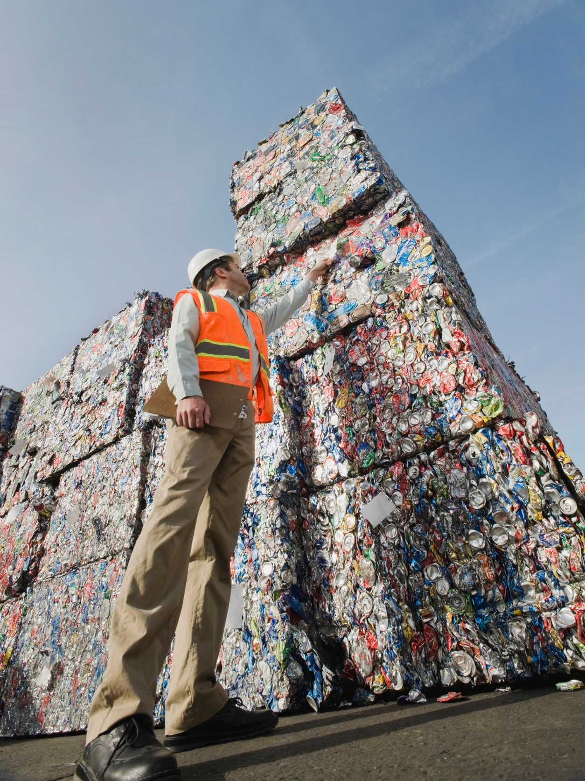
Visualize Workflow
Unlike manufacturing, IT work is invisible and prevents us from managing our work
Types of work: Project, SWI, Base support, Initiative
ITSM is not a work management tool
Does not have all types of work
No work breakdown & hierarchical structure
No ability to plan & prioritize the work

Slide 33
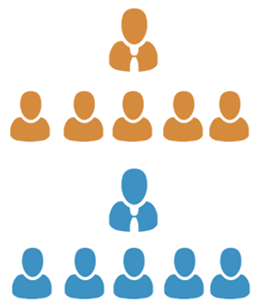

Team Types
Command & Control
Self-Organizing team
Servant Leadership
Management-directed team
Traditional Team
Agile Team
Notes:
Objective:
How your Kanban team should be structured
Silo vs. cross functional -
Commend & Control – Bottleneck at the lead, things are slow | Work goes through multiple team and causes delay in the flow
Self-organizing – Get things done fast. Delegate decision to the team. Get things done faster. Motivated individuals.

Slide 34
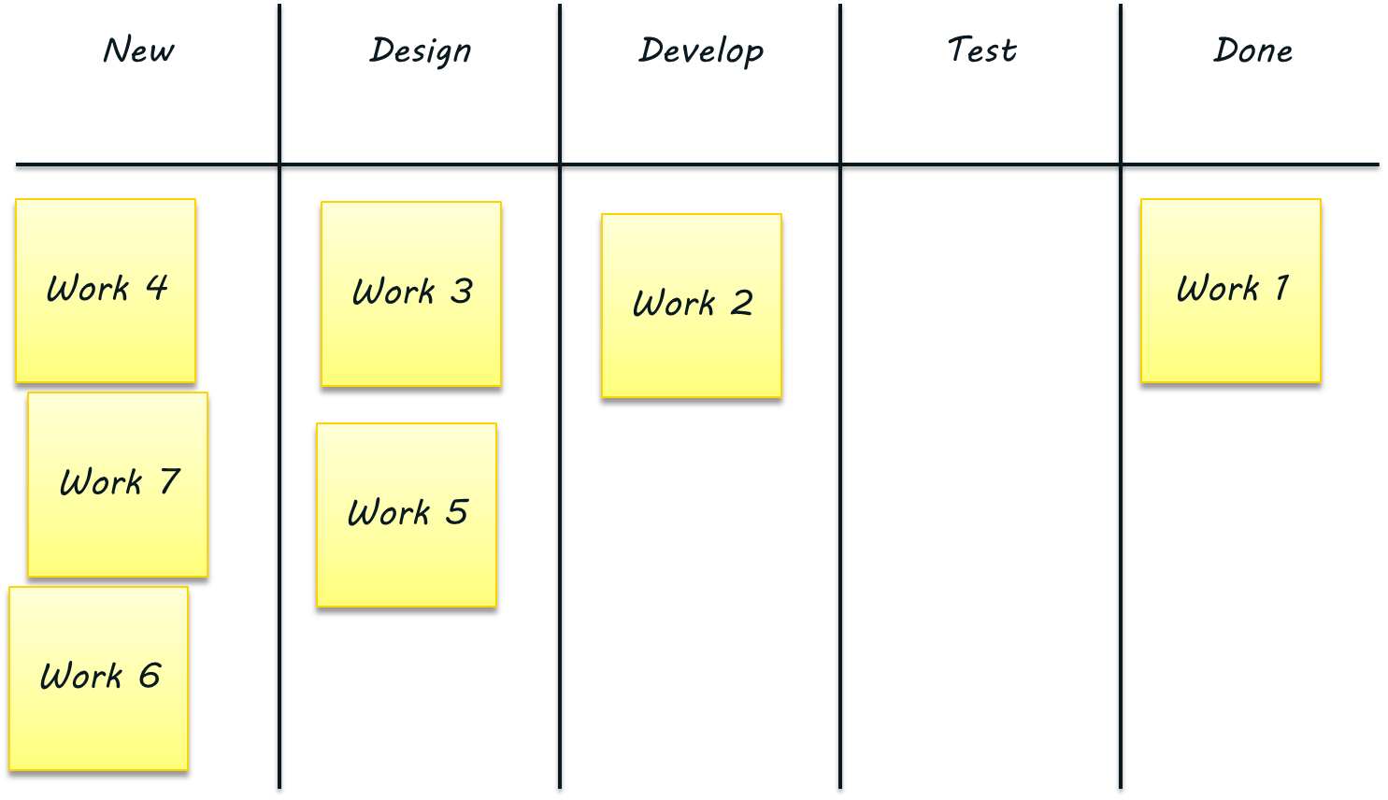



ITSM
Project work
INC or WO via emails, phone calls
SharePoint List
Kanban Board
Kanban Team
Notes:
After you have a team, then we start to visualize work
You may have multiple sources of work, tickets in ITSM, SharePoint initiative list
Everything that the team is working on has to be on one board (We should not manage other types of work aside as it will allow people to use items out side of the board as an excuse, )

Slide 35






Visualize Workflow
Manager
Stakeholders
New
Ready to start
Design
Develop
Test
User test
Ready to deploy
Power User
Designer
Developer
Designer
Business User
Notes:
Objective
<1> Define team boundaries = Start & end point in the process = New (new item is created) & Ready to Deploy (end of the team process as after the item is in this state, the other teams will deploy change to the production)
<2> Value-added steps = In order to move items to the end, there are several steps that the team has to do.
<3> Each step involves different skillset in the team – One person can involve in multiple steps, e.g., designers who do both design & test
<4> Don’t forget to include people who need to get the information like stakeholders as well

Slide 36
Visualize Workflow – Priority & Blockers
New
Ready to start
Design
Develop
Test
User test
Done
Question for customer
4/21
Work 4
Test fails
4/15
Work 7
Mike
3/27
Work 2
John
5/9
Work 12
Victoria
4/13
Work 1
5/4
Work 15
John
Wait for business
Test fails
Mike
5/1
Work 3
Mike
5/2
Work 10
5/4
Work 6
Sarah
Blocker created
4/5
Work 8
5/4
Work 13
Sarah
4/23
Work 5
Chris
5/7
Work 14
Prioritized by customers
4/22
Work 9
Mike
Need help on design
5/9
Work 11
Wait on architect
Notes:
All work items start from the left. The first step that we highly recommend teams to do is to prioritize <1>. Then customer will prioritize the work and move it to Ready to Start column <2>
<1> The starting point of the process is to have work items coming from the left.
Let’s say, I am a designer. I start the process by pulling one work item from ready column to design column. <2> Then I put my name on it (John in this example). <3>
<4> The rest of the items in Ready column fills the place of Work 4.
Then after a while, we will get items spread around the board. <5>
Next, let’s say that test fails (Work 2) <6>. By common sense, we will just move the item backward to Dev column. However, we don’t do that in Kanban. Why? Because we don’t want the item to lose its place in the queue. Since it is almost done, why we mix it up with other items which have not even started.
Rather than moving the item back, in Kanban, we use a blocker to visualize the issue instead <7>. Now, the issue is visualized and developer can come and help, let’s say, Mike helps on this issue. <8>
Blockers can occur anywhere in the process <9>, maybe I need clarification of the requirement from business or a developer requires approval before making a major change to a global application. Or even a blocker on something that you might be able to do it, but it could be faster if someone else can help you. <10>
What you can see from the slide?
Number of work items in progress
Item status
Workload
Bottleneck
Aged item
Blockers
Finished items per month
Visualization does not cause problem, it uncovers the problem

Slide 37
Visualize Workflow
Blockers
Priority
Bottlenecks
Status
Workload
Work In Progress
Notes:
What do you see on the Kanban Board?

Slide 38
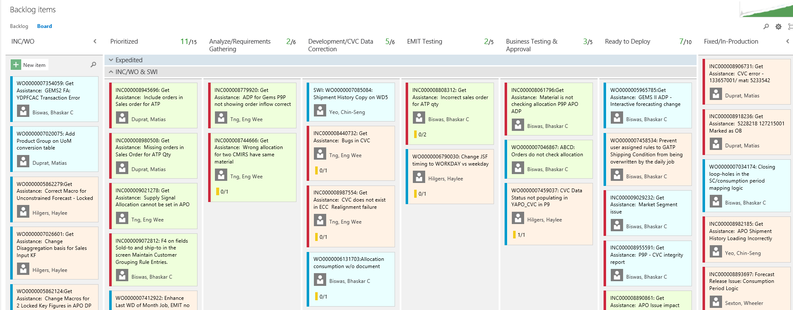
Example - TFS
Notes:
Example: Planning ADP – Supply Chain team in M&S
Color represents the application.

Slide 39
Critical Practices in a Kanban Team
Make sure that everything the team is working is on the board
Keep the board up to date
Blockers - Put on a blocker for these scenarios
Waiting for someone to take an action (internal or external)
Need help from someone in the team

Slide 40

Common problems in teams
Transparency
Who is doing what
Organization is a black box
Priority
Busy with low priority work
Collaboration
Task driven
Silos
Big picture
Not empowered / motivated
Focus
Multitasking
Start work but not finish it
Squeaky wheel
Improvement
Team goal
Lack of metrics
Commitment to customers
Unaligned across the team
Notes:
With the first practice, visualize workflow it helps solving the problems of:
Transparency – This starts to give customers & team members holistic view of how the team is working
Partially solve the priority part as it allows us to see which item is being worked and we start to realize that we might be working on the wrong priority, still, there is no mechanism to prevent that though
Partially solve the collaboration problem with blocker concept.

Slide 41
Kanban Practices
Kanban Practices
Visualize Workflow
Limit Work-in-progress
Manage flow
Make policies explicit
Improve Collaboratively Explore
Experimentally
Implement feedback loop

Slide 42
Work in Progress (WIP)
A team’s partially finished work waiting for completion

Slide 43
Efficiency
Higher resource utilization
(Input / Resources)
Better throughput
(Output / Resources)
More work gets started
More work gets done
Notes:
We want to utilize our resources at 100% at anytime (no idle time) More work into each individual queue will create pressure that will get things done faster

Slide 44
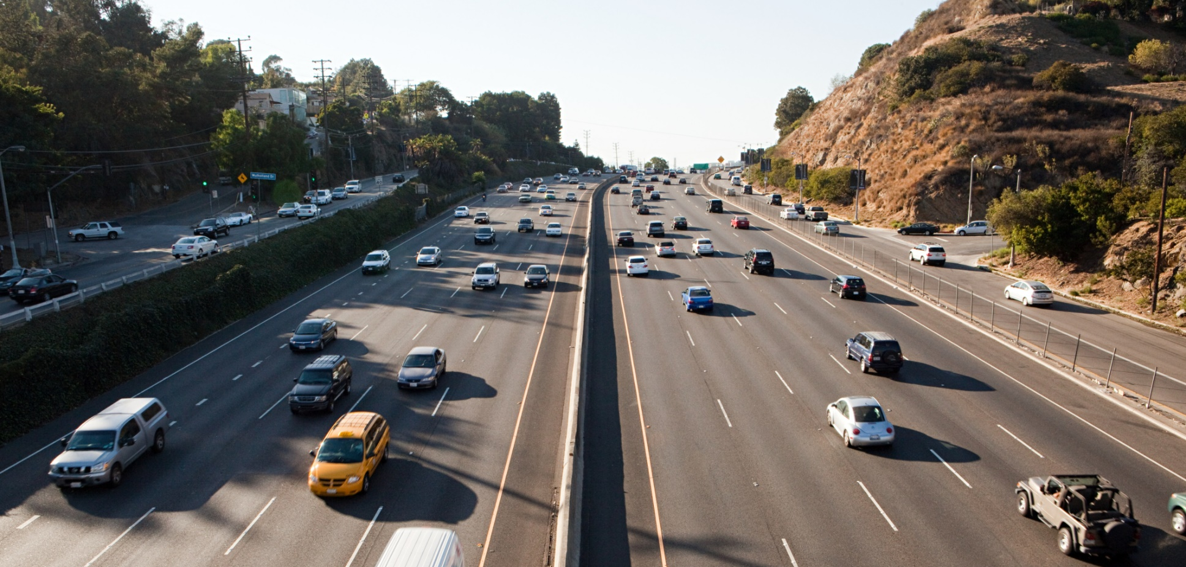
Highway Efficiency
Notes:
So, let’s take this highway for example (note the sweet blue Caddy!). We have a number of cars on the highway (let’s think of this as WIP), and at this stage, things are flowing nicely. The highway is able to handle a good amount of variability…if all of the cars on the right were to suddenly merge onto the highway as opposed to the side road, everything would probably be fine.

Slide 45
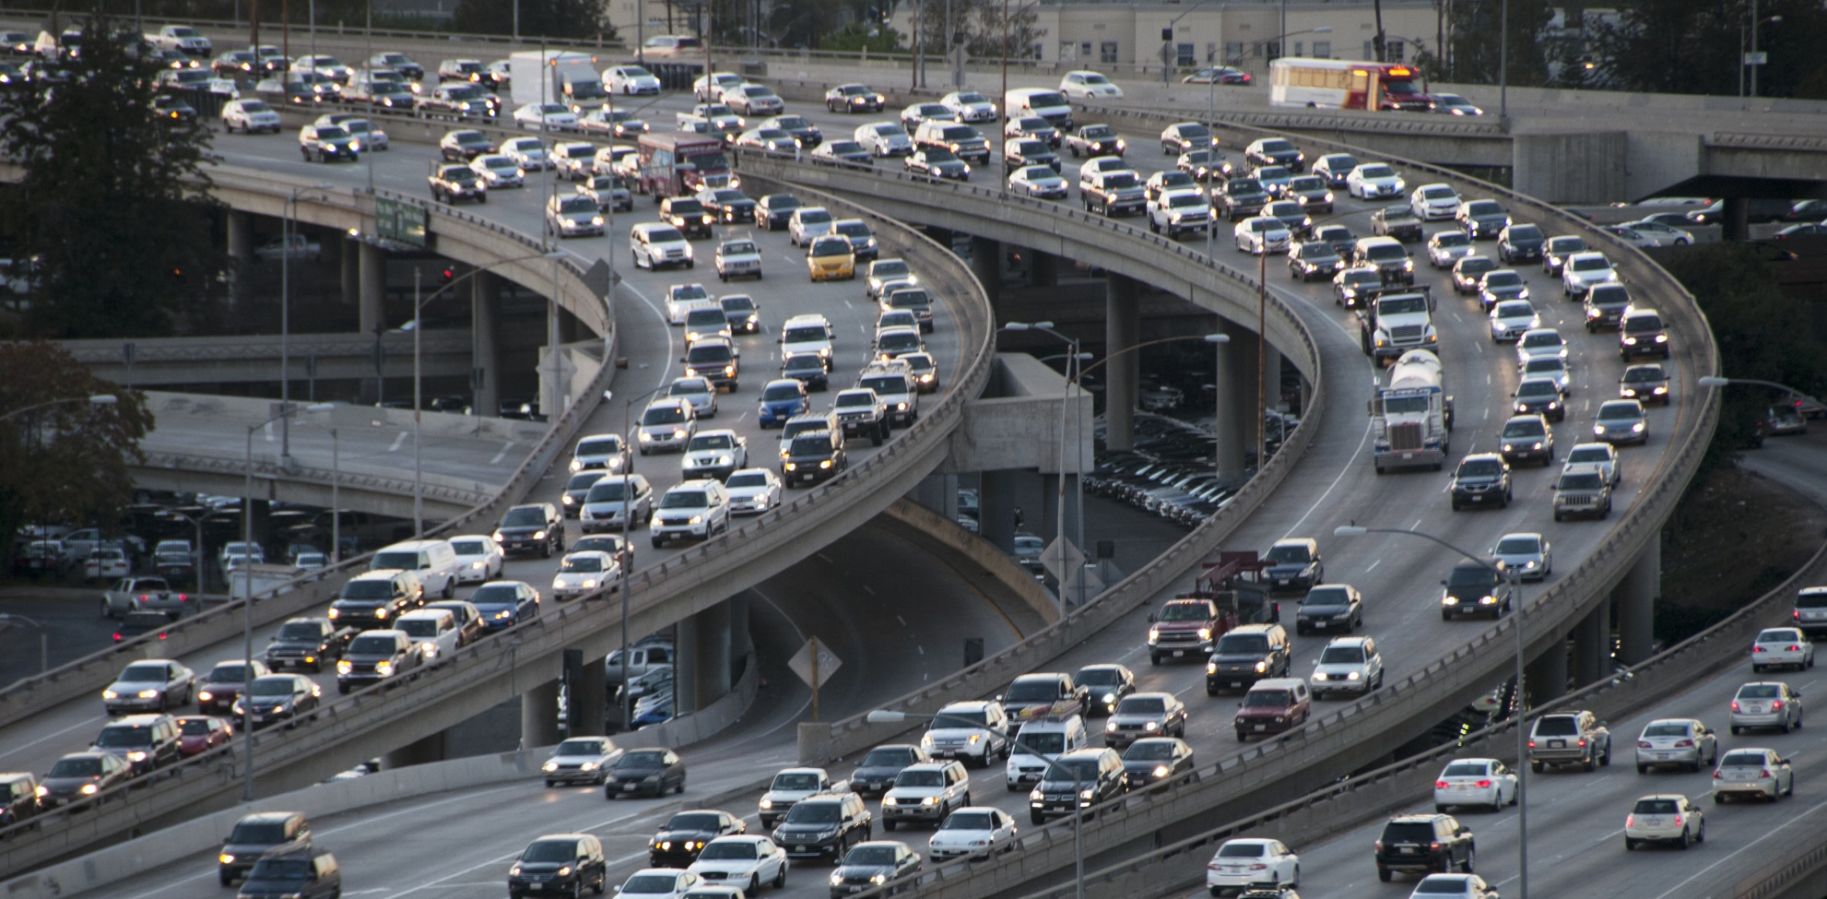
Highway Efficiency – 100%
Notes:
Mike’s Script
That’s right – a highway that is 100% utilized generates a complete gridlock. If there is any variability (say an accident, or extra people merging onto the road – i.e. more WIP), the already moving road comes to a screeching halt. This is something that science has told us time and time again….<next slide>

Slide 46
Efficiency
≠
Higher resource utilization
(Input / Resources)
Better throughput
(Output / Resources)
Less
More work gets started
More work gets done
& Slower
46
Notes:
We want to utilize our resources at 100% at anytime (no idle time) More work into each individual queue will create pressure that will get things done faster

Slide 47
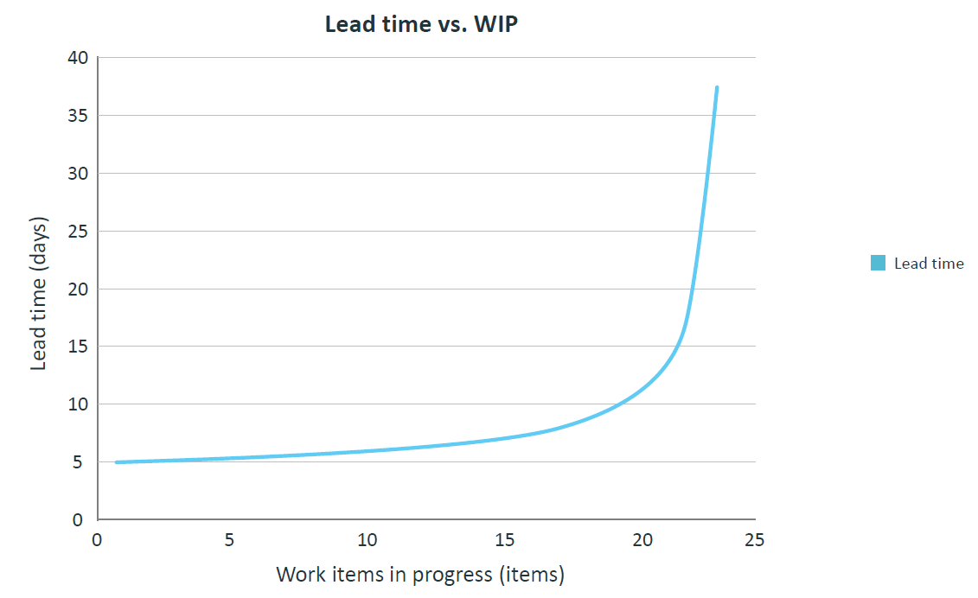
High WIP increases lead time
Notes:
Example: CPU utilization

Slide 48
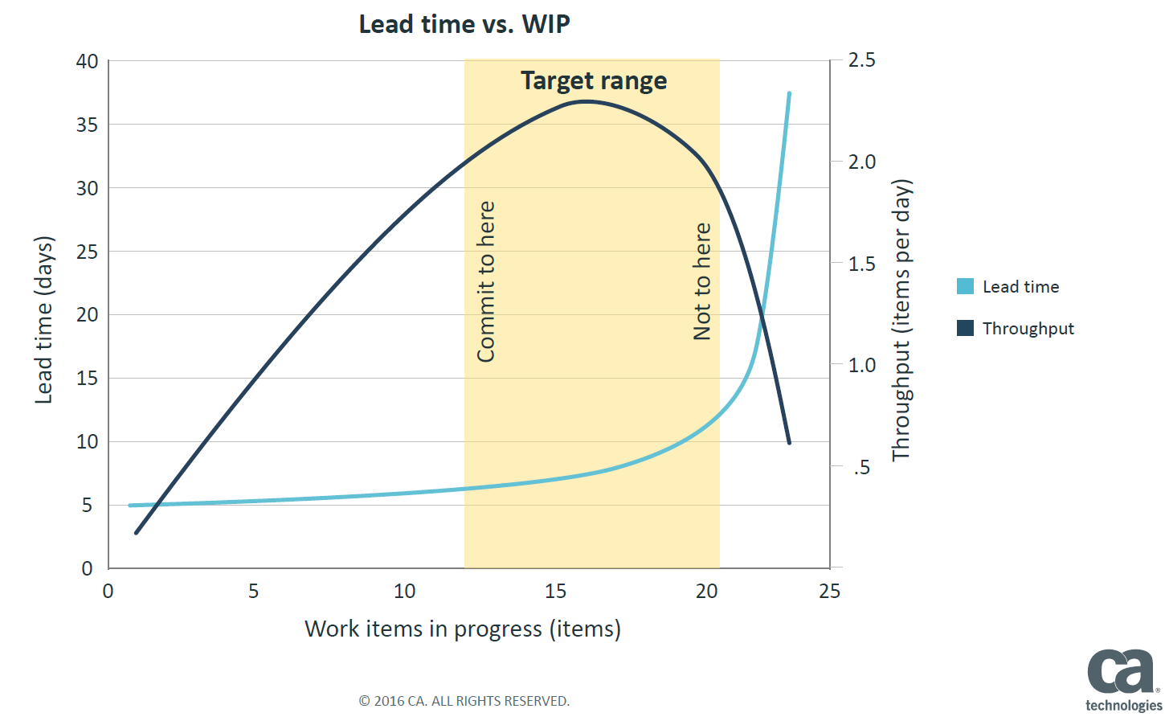
High WIP reduces throughput
Notes:
Multitasking also impacts speed,
Mike’s Script
As we get closer and closer to 100% utilization, our lead times (or waiting times for the customer) increase EXPONENTIALLY! This was originally discovered in the manufacturing world, but is also true for our work. People who are 100% busy on large amounts of work will struggle to deliver things regularly.
It’s the same as printer. You cannot make printer print faster by feeding more paper into it.
10% = 10/90
90% = 90/10

Slide 49

Exercise:
We are going to deliver 3 features to our customers
Feature 1 – 1 2 3 ….. 10
Feature 2 – A B C ….. J
Feature 3 – I II III …… X
1st Round - Serial delivery
Finish one feature at a time
2nd Round - Parallel delivery
Work three features at the same time
Notes:
Two ways:
Complete a series before moving on to the next one (12345678910ABCDEFGHI…. VIII,IX,X)
Write first character of all the series, then second, third, etc. (1AI2BII3CIII, ….., 10JX) – Make sure that they write them in a sequence, not write 1 – 10 and leave gaps to fill in A and I later.
Time both ways and see the difference which is an inefficiency due to multitasking / context switching

Slide 50

Multitasking quote
Those who are constantly breaking away from tasks,
saw the equivalent of a 10-point fall in their IQ
- Institute of Psychiatry, King ‘s College
Notes:
Multitasking also impacts product quality – IQ drop

Slide 51
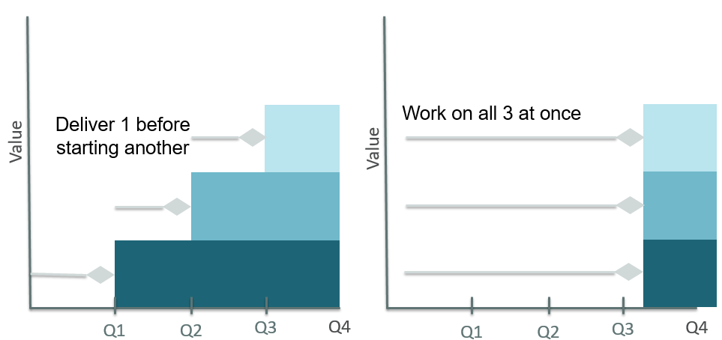
Serial delivery vs. parallel delivery
Notes:
Have priority given is always better as it keeps IT people to focus on get one things done, rather than switching around multiple items and get things done later

Slide 52

High WIP distracts us from improving ourselves
Notes:
E.g., I want to spend some more time to fix the root cause of the problem but I need to deal with the support tickets first

Slide 53

Effects of high WIP
Increase overall lead time
Reduce throughput
Increase context switching overhead
Delay value delivery
Reduce quality
Distract us from improving ourselves

Slide 54

WIP is a silent productivity killer

Slide 55
How many in-progress items
do you have?
Notes:
How many in-progress items do you have?
How many that you are actively working? All of them at the same time?
How could that happen? (Have a lot of items in the queue)

Slide 56
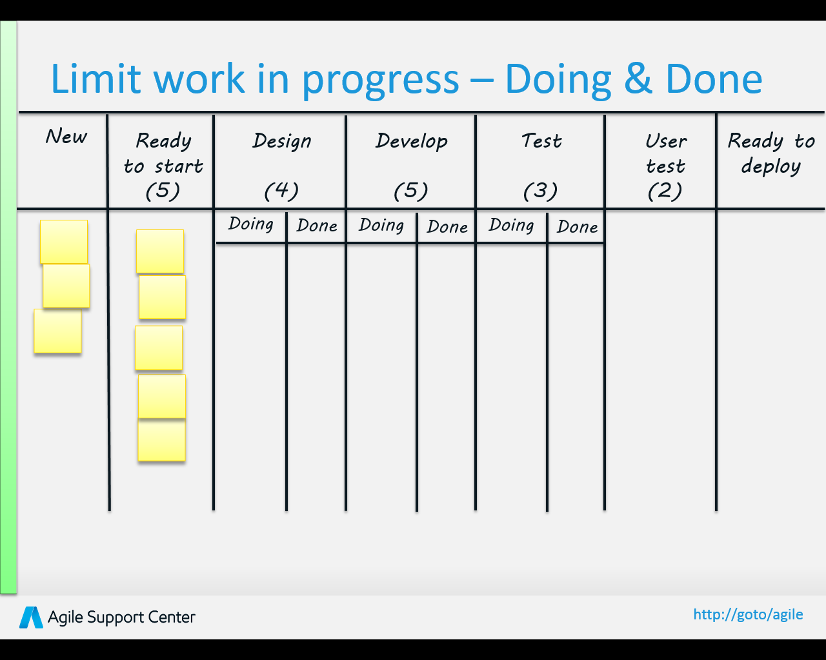
Today situation
WIP
New
Design
Develop
Test
User test
Done
Notes:
Today, we have a lot of items in progress. That makes board here looks very busy.
People focus on reducing items in the New column by shoving them into the team, similar to adding more cars to a jammed highway. This makes situation even worse as the team has to juggle more work than they can do and less work gets done.
In Kanban, we want to focus on getting things out of the board (move them to done). We may need to leave items in New state longer, but that is not a bad thing though.

Slide 57
3 ways to control Work in Progress (WIP)
Pull system
WIP
limits
Right to left
Analyst should start new work only when they have cycles
Limit the number of work items that can be in each column
Stop starting & start finishing
Notes:
3 ways to reduce WIP

Slide 58
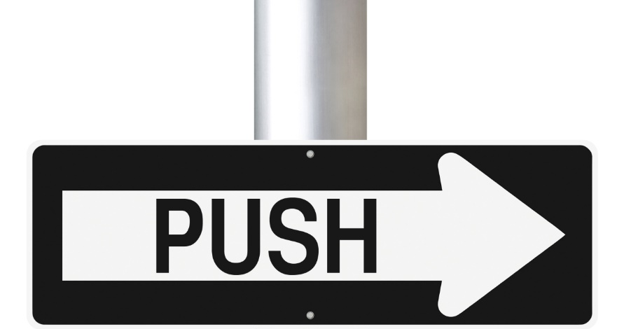

Main queue
Individual queue
Notes:
That’s because today we push work to people through the concept of dispatching, load balancing
And we believe that ->

Slide 59
Focus
Reduce amount of work in progress (WIP) to get it done faster
Notes:
What we need is around focus – Have fewer items, focus on them and get them done faster. Focus also improves quality

Slide 60
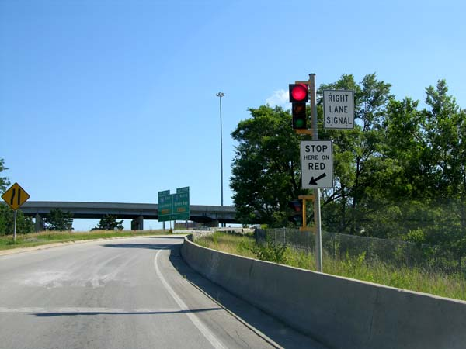
Ramp traffic light
Notes:
This is the way they prevent too many cars to get on to highway

Slide 61


Main queue
Individual
Notes:
We do pull concept instead of pushing.
People will grab the work as they can do, then they will not take any more work, unless:
They finish with the item, then they can grab another one
They are blocked by a blocker and they can no longer proceed on that item
Then that triggers pull process where they will pull a new work item that is the most valuable item for customer at that time

Slide 62
Pull approach
New
Design
Develop
Test
User test
Done
Notes:
With this approach, a number of items is reduced then the team can better focus on their work, get it done with better quality

Slide 63
Pull
Empower analysts to start new work only when they have cycles

Slide 64
If we keep pulling, won’t items still overload the board?

Slide 65
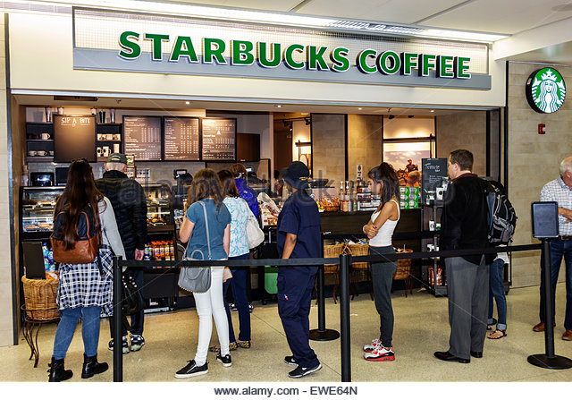
Starbucks example
Notes:
One good behavior that we observe from Starbucks is that, when baristas behind the counter are totally busy, then they stop taking orders. Instead, order takers go and help prepare those drinks. So that people can happily get out with their coffee. Then, they resume taking orders.
They are controlling a number of Work in Progress (which is a number of drinks) not to exceed the threshold.

Slide 66
Work in Progress (WIP) Limit
Limit a number of items being actively worked by a team

Slide 67
Limit work in progress – Doing & Done
New
Ready to start
(5)
Design
(4)
Develop
(5)
Test
(3)
User test
(2)
Ready to deploy
Doing
Done
Doing
Done
Doing
Done
WIP Limits
Prevent over- utilization
Doing / Done
Allow pulling at other columns
Notes:
How can we apply this to IT work? First we add work in progress limit under each column name. We put doing & done just like the burger process. Each column cannot have more items that the WIP limit. This includes both “Doing” and “Done” work and it is the number of entire team.
How does WIP limit impact the process?
Ready to start – Rather than asking customers to prioritize 100 tickets at a time while the team can do 20 tickets per month (similar to producing too many tomato buns). We just put a limit to help customers, not to prioritize too many things which will save their time and focus more on quality of prioritization.
In this case, customers need to prioritize only top 5 items.

Slide 68
Limit work in progress – Doing & Done
New
Ready to start
(5)
Design
(4)
Develop
(5)
Test
(3)
User test
(2)
Ready to deploy
Doing
Done
Doing
Done
Doing
Done
Pull new work
Work finished
Notes:
Objective:
WIP limit is for entire team, not for individual.
Show pull concept.
Why do we have WIP limit?
Reduce multitasking
Break silos
Now, how does it work with IT. Let’s say I am a developer of this team and I am working on the first item. Once I finish it, I move that item to done <1>. Then I move on to the second item and then, I could not move on as the requirement is not clear. I need help from the designer so I put a blocker there <2>. The item after that is being worked by another developer. I will leave him for now.
Currently, I have 4 items in Develop column out of 5 WIP limit so I can pull one more item <3> from the design done column in. This is not a push from Design to developer but more developer pulls work from design team. I continue work on this but again, I need a test case to move on and I have to wait again for the designer. Let’s put a blocker for that <4>.
Since I have nothing to do so let’s pull one more item in here <5>, and you cannot. Why? Because I am already at the WIP limit. First this helps us to focus on the items and get it done, rather than keep pulling work and get nothing done. Second, it helps us focus and reduce multi tasking. Typically, developer should go back and look at other items in that column if he/she can help on any of those. In this case, he cannot. Does it mean he can leave early today? Of course not. Look closely, there are two items those are already done in develop and they are pulled to Test then develop column will have one more spot. Why can’t Test column pull a new item? That’s because they are also at the WIP limit. As a developer, if I can get rid of this blocker <6> then the item can be moved to Test done and a user can pick it up for User test <7>. Now Test column has one slot available and they can pull one more item from develop <8>. Eventually, the developer can pull an item from design. This is how WIP limit helps breaking team silos and help each other.
Clarify where the finished items are
The goal is not to maximize items in the column
Pull concept

Slide 69
Limit work in progress
Stop starting, start finishing
Benefits
Reduce lead time
Focus more on getting work done
Reduce multi-tasking
Help identify impediments
Encourage collaboration, break team silos
Improve quality
WIP limits are up to the team
Starting point could be 1-3/person doing the work
They can change afterward

Slide 70
Critical Practices in a Kanban Team
The heart of Kanban is to control WIP
Pull work only if you are able to do it
When you finish the previous item
When you have a blocker
Respect WIP limits
It can be adjusted over time
Stop starting, start finishing
Work as a team, get rid of silos

Slide 71
Common problems in teams
Transparency
Who is doing what
Organization is a black box
Priority
Busy with low priority work
Collaboration
Task driven
Silos
Big picture
Not empowered / motivated
Focus
Multitasking
Start work but not finish it
Squeaky wheel
Improvement
Team goal
Lack of metrics
Commitment to customers
Unaligned across the team
Notes:
With the first practice, visualize workflow it helps solving the problems of:
Transparency – This starts to give customers & team members holistic view of how the team is working
Partially solve the priority part as it allows us to see which item is being worked and we start to realize that we might be working on the wrong priority, still, there is no mechanism to prevent that though
Partially solve the collaboration problem with blocker concept.

Slide 72




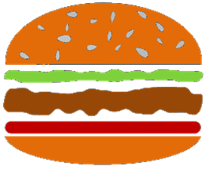
Burger production
Notes:
Here is our burger shop. We have four chefs those work together to deliver the burger.

Slide 73
Burger production
Bottom Bun
Tomato
Patty
Lettuce
Top bun
Burger Ready
Tomato
6 seconds
Beef Patty
15 seconds
Lettuce
5 seconds
Top bun
3 seconds
Notes:
First, we start from the bottom bun -> tomato guy will put a tomato on it and pass it over to the second guy here, called beef patty guy. He takes some time to grill a patty, then the lettuce guy will put lettuce on before the Mr. Top Bun will put on a bun then the burger is ready.
If we map that with Kanban then it will look like this.
The time shows how long does it take in each step.

Slide 74


Burger production - Push
Tomato
6 seconds
Beef Patty
15 seconds
Lettuce
5 seconds
Top bun
3 seconds
59
44
29
Notes:
Let’s run this process for one minute and see how the result is delivered.
Before that, let me explain how they work together.
Blue box = item in process
Whenever they finish, they will toss the item over the well to the chef on the right. Everybody is going to be busy on their stuff.
Key points
Initial lead time = total time in each step (ignoring idle time between steps) = 6 + 15 + 5 +3 = 29 = The time that first burger came out
Lead time depends on time spent in the Bottleneck process
Time difference between each burger = 15 = bottleneck time
Improve bottle neck = improve lead time
Do we know our bottleneck today?
Over production on the first step
If this continues then we will have tomato bun piling up
This is a waste of process = after a while, those tomato bun will get soaked and become a waste
Although tomato guy is busy, it does not give any value as most of them will not reach the customers
This is push system as the upstream step tries to produce as many as he can and push his product to the downstream step without considering its consumption
I produce as many as I can. I put my product in your space so it is your responsibility

Slide 75
Burger production - Pull
Tomato
6 seconds
(Limit 2 pieces)
59
Beef Patty
15 seconds
Lettuce
5 seconds
Top bun
3 seconds
44
29
Notes:
How can we prevent the first guy from producing waste. It is obvious that the tomato guy oversupplies the beef patty guy. This time we want to change this to be a pull process which has two major changes here.
limit items in the first step to two. The tomato guy has to stop product when he has two items in the beef patty queue.
Since tomato guy has to see how many tomato buns that beef patty guy has, rather than tossing over tomato bun, he has to keep the finished product in upstream inventory, waiting until the downstream is available and then pull a tomato bun to work on
Conclusion, introducing WIP limit does not impact result but the tomato guy has more slack time + less waste in the process
The output does not change. You still get three burgers, but the total time the burger is “in progress” is less for the later ones. Also, tomato guy could now help in other areas.

Slide 76
Kanban Practices
Kanban Practices
Visualize Workflow
Limit Work-in-progress
Manage flow
Make policies explicit
Improve Collaboratively Explore
Experimentally
Implement feedback loop

Slide 77


Manage flow
Develop
(5)
Ready to deploy
Done
New
Ready to start
(8)
Design
(4)
Test
(3)
User test
(2)
Doing
Done
Doing
Done
Doing
Done
Throughput
= Output per period
Cycle time = Time from ready to start until complete
Lead time = Time from created until it reaches customer
Notes:
Lead time = Time once the item is created until it goes to the last state in the flow
Throughput = Amount of work that can reached the last state in a fixed period of time
The goal is to maximize value to customer
- reduce lead time
- Increase finished item
- Improve quality
Manage flow = balance between lead time and throughput

Slide 78
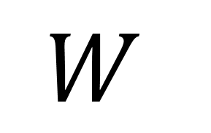
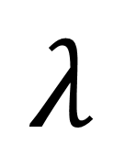

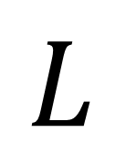
Little’s Law
Work in Progress
$$L$$
$$W$$
$$=$$
$$λ$$
Cycle time
Throughput
Notes:
Little’s law
Speed is considered by lead time. We want to reduce lead time and we can do it by either reduce number of work in progress or increase throughput
We can reduce Work in Progress by reducing WIP limit. If we go extreme by reducing WIP limit down to one, we will get things done a lot faster but we will underutilize our resources. We have to balance between Lead Time & Throughput.

Slide 79
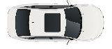

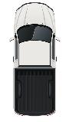
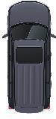



Manage flow
One-way Traffic flow
Notes:
In order to make the traffic flows, which traffic light should turn green first, right or left?
Left = just one car can move to the right, the rest is still stuck
Right = Clear the car on the right first so that the car on the left can replace the spots

Slide 80
Manage flow
New
Ready to start
(8)
Design
(4)
Develop
(5)
Test
(3)
User test
(2)
Ready to deploy
Doing
Done
Doing
Done
Doing
Done
A
Dev
C
B
Items move from
left to right
Priority starts from right to left
Notes:
Between work A & B, which one we should start first -> B to allow better flow + finish more items
Between work C & blocker on the right -> Blocker allows better flow
That’s why priority starts from right to left
Focus on bottleneck
Anyway, it is not always true, depends on some other factors (e.g., bottlenecks, blockers, priority). We need to collaborate to understand team’s priority.

Slide 81
Different type of work
Deadline
Initiatives
Incidents
Emergency Issues

Slide 82
Class of Service - Example
One at a time
Ignore WIP limit
Expedited Items
Fixed Delivery Date
By 3/21
No additional value if delivered early
Standard
FIFO + SLA
Intangible
Best Effort
Notes:
Cost of delay
Expedited item – One at a time and ignore WIP limit
Fixed delivery date – Has a required date on the card
Standard class
FIFO
Has SLA – E.g., 30-day lead time by 80%
Intangible
Does not have SLA

Slide 83
Manage flow
New
Ready to start
(8)
Design
(4)
Develop
(5)
Test
(3)
User test
(2)
Ready to deploy
Doing
Done
Doing
Done
Doing
Done
Expedited Items – WIP Limit 1
3/1
Items move from
left to right
Priority starts from right to left

Slide 84
Collaboration
 | Queue Replenishing | Stand-up Meeting
Objective | Choose items to replenish the input queue | Discover blockers in the flow Understand team priority
Cadence | Bi-weekly or Weekly (more frequent is better) | Daily
Attendees | Leads in Agile team + value team | Agile team
Format | Each of the members comes with a prioritized list of items. They discuss which items will be put to the input queue first, focusing on value | Facilitator walks the team through the board and focuses on blockers
Notes:
Objective:
In order to understand the flow & priority, the team has to collaborate
Queue Replenishing – Prioritize items into Approved column (Customers to discuss their priority)
Stand-up meeting – Discover blockers in the flow & Understand team priority
- Virtual team = Have local stand-up meeting

Slide 85
Collaboration for Projects (today)
 | Release Planning | Queue Replenishing | Stand-up Meeting
Objective | Define deliverable’s scope for the release | Decide if budget remains for changes requested | Discover blockers in the flow & understand team priorities
Cadence | Beginning of Project + Close to the end of every release cycle | Ad-hoc | Daily
Attendees | Leads of Agile team | Leads of Agile team + project management team | Agile team
Format | Review finished items in this release. Plan any other items that need to be included in the release. | Changes to scope are discussed to determine if budget exists for inclusion or if CM process starts | Facilitator walks the team through the board and focuses on blockers
Notes:
[Project slide]
In order to understand the flow & priority, the team has to collaborate
Release planning – Similar to Scrum. Plan the deliverables in the scope
Queue Replenishing – Prioritize items into Approved column (Customers to discuss their priority)
Stand-up meeting – Discover blockers in the flow & Understand team priority
- Virtual team = Have local stand-up meeting

Slide 86
Critical Practices in a Kanban Team
Manage flow as a team
Increase team’s throughput
Help each other get rid of bottlenecks / blockers
Focus on items on the right first
Have a frequent stand-up meeting
Discover blockers early
Align priority
Keep the board up-to-date

Slide 87
Common problems in teams
Transparency
Who is doing what
Organization is a black box
Priority
Busy with low priority work
Collaboration
Task driven
Silos
Big picture
Not empowered / motivated
Focus
Multitasking
Start work but not finish it
Squeaky wheel
Improvement
Team goal
Lack of metrics
Commitment to customers
Unaligned across the team
Notes:
With the first practice, visualize workflow it helps solving the problems of:
Transparency – This starts to give customers & team members holistic view of how the team is working
Partially solve the priority part as it allows us to see which item is being worked and we start to realize that we might be working on the wrong priority, still, there is no mechanism to prevent that though
Partially solve the collaboration problem with blocker concept.

Slide 88
Kanban Practices
Kanban Practices
Visualize Workflow
Limit Work-in-progress
Manage flow
Make policies explicit
Improve Collaboratively Explore
Experimentally
Implement feedback loop

Slide 89
What needs to be explicit
Roles & Responsibility
New
Ready to start
(8)
Design
(4)
Develop
(5)
Test
(3)
User test
(2)
Ready to deploy
Class of Service determination rules
Doing
Done
Doing
Done
Doing
Done
WIP Limit
Expedited Lane
3/1
Definition of New
Definition of Done
Notes:
Definition of New – Criteria of items that have to be on the board (e.g., anything that requires more than 15 minutes to do has to be on the board)
Definition of Done
Class of service determination rule – E.g., In which case we can promote items to expedited lane
WIP Limit – Both columns & swim lanes
R&R

Slide 90
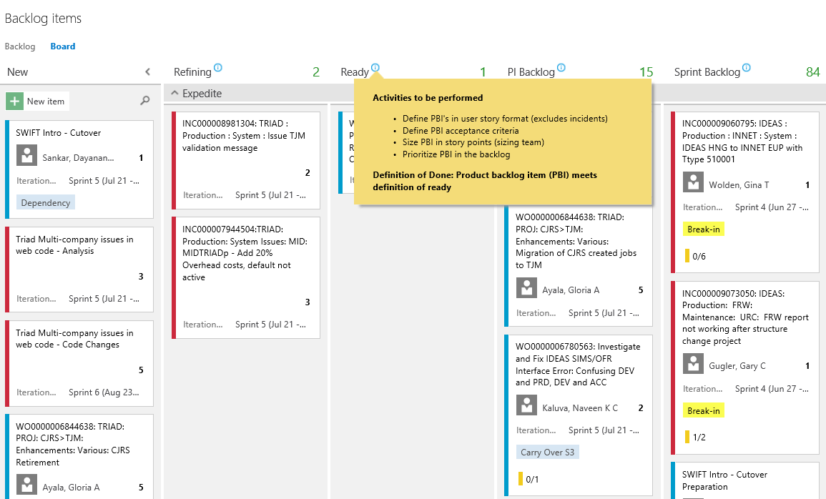
Example – Definition of Done
Notes:
IDEAS example

Slide 91
Kanban – Roles & Responsibilities
R&R is not defined in Kanban. It is mostly up to the team
Facilitator
Facilitate the team for meeting & data
Help the team identify & deal with blockers
Value team
Regularly fill the input queue (“Ready to Start”) based on priority
Team members
Work on right priority (Right to left / bottleneck)
Raise blockers
Keep the board up to date

Slide 92
Make policies explicit
What policies should be explicit?
Roles and responsibilities
Process flow
Definition of Done
WIP Limit
Class of service determination
Etc.
Benefits
Align understanding
Ensure quality
Build trust on the system
Notes:
What policies should be explicit?
Roles and responsibilities – Who is doing what in which column
Process flow
Definition of Done
WIP Limit
Class of service determination – This aligns IT & customer on which item can be promoted to “expedited”
Etc.
Benefits
Align understanding
Ensure quality – Definition of Done
Build trust on the system – Customers trust in IT that we always work items in priority

Slide 93
Make policies explicit - projects
What policies should be explicit?
Roles and responsibilities
Process flow
Definition of Done
WIP Limit
Class of service determination
Scope
Etc.
Benefits
Align understanding
Ensure quality
Build trust on the system
Notes:
[Project slide]
What policies should be explicit?
Roles and responsibilities – Who is doing what in which column
Process flow
Definition of Done
WIP Limit
Class of service determination – This aligns IT & customer on which item can be promoted to “expedited”
Scope
Etc.
Benefits
Align understanding
Ensure quality – Definition of Done
Build trust on the system – Customers trust in IT that we always work items in priority

Slide 94
Kanban – Roles & Responsibilities projects
R&R is not defined in Kanban. It is mostly up to the team
Facilitator
Facilitate the team for meeting & data
Help the team identify & deal with blockers
Project Management Team
Manage scope of project
Team members
Work on right priority (Right to left / bottleneck)
Raise blockers
Keep the board up to date
Notes:
[Project slide]

Slide 95
Kanban Practices
Kanban Practices
Visualize Workflow
Limit Work-in-progress
Manage flow
Make policies explicit
Improve Collaboratively Explore
Experimentally
Implement feedback loop

Slide 96

Implement Feedback Loop
Evolutionary process cannot work without feedback loops
Notes:
Objective?
Are we doing good today? How can you measure that? Silo prevents people to realize the real situation of the team.
If we take a test and we do not know our score, we will never know how good we are.
We need to implement the team scoring system, to feedback the team whether we are doing good or not.

Slide 97

Define Metric Period

Slide 98

What we want to measure
Lead & cycle times
Waiting time for customers
Throughput
Output per period
Lead time analysis
Waiting time for each column
Blocker analysis
Impact for each type of blocker
Notes:
Lead & cycle times = Team’s performance in term of speed
Throughput = Team’s performance in term of amount of finished work
Lead time analysis = Find out where the bottleneck is
Blocker analysis = Find out what’s the root cause of bottlenecks

Slide 99
Implement Feedback Loops
Metrics – Understand where you are & where you can improve
Metrics should be done on a cadence
Metrics in Kanban
Average lead time
Lead time confidence level
Input / Output
Cumulative Flow Diagram
Lead time analysis
Blocker analysis

Slide 100
Implement Feedback Loops
Metrics – Understand where you are & where you can improve
Metrics should be done on a cadence
Metrics in Kanban
Average lead time
Lead time confidence level
Input / Output
Cumulative Flow Diagram
Lead time analysis
Blocker analysis
Velocity
Notes:
[Project Slide]

Slide 101
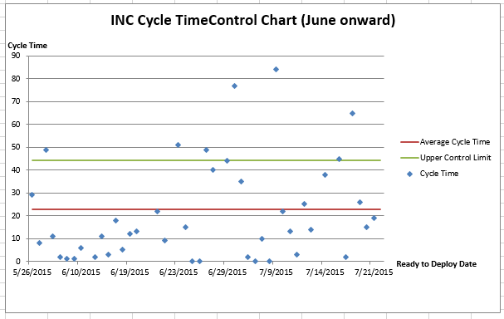
Average Cycle Time / Lead Time
Notes:
Objective:
Average lead time measures how long does the customer need to wait until they get things done (in average)?
The team is responsible to reduce lead time, by reducing cycle time
Upper Control Limit: 2 standard deviations…use this to identify items to review (the why it’s a long lead/cycle time).

Slide 102
Average Lead Time
Average Lead Time = Average lead time for all items finished in a fixed period of time
This information can be useful to estimate lead time for future items
Can be used together with sizing for more precise estimate
Notes:
Objective:
Average lead time measures how long does the customer need to wait until they get things done (in average)?
The team is responsible to reduce lead time, by reducing cycle time

Slide 103
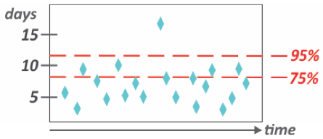
Lead Time Confidence Level
Lead Time Confidence Level – Probability that items will be done for a specific lead time
From the graph below
LTCL = 95% - An item will be done in 12 days
LTCL = 75% - An item will be done in 8 days
Can be used together with sizing for more precise estimate
Notes:
Objective:
This is the same as SLA (Service Level Agreement).

Slide 104
Input / Output
Input = Items created in a timespan
Does not mean approved items
Output = Items finished in a timespan
Similar to throughput
Goals = Increase output while reduce input

Slide 105
Input / Output
Input / Output = Growth rate
If trend of ratio is > 1 = Work coming in is more than the capacity of the team
If trend of ratio is < 1 = Work coming in is less than the capacity of the team
Possible Decisions
Enlarge or reduce team size
Improve the process
Merge teams
Get more works to feed

Slide 106
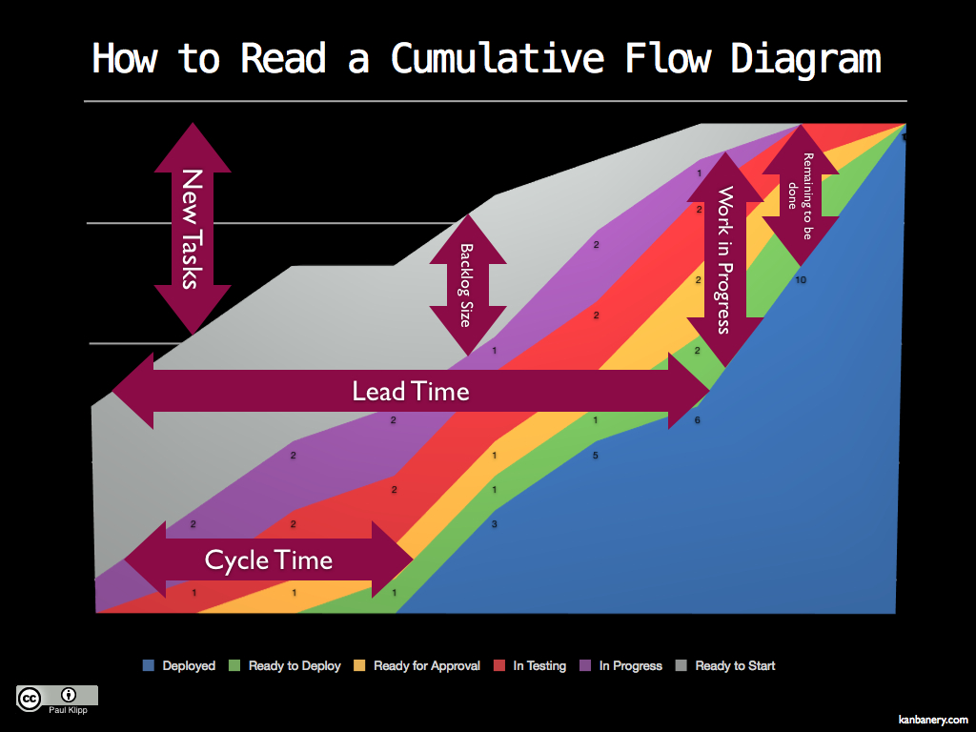
Cumulative Flow Diagram (CFD)
# of Items
Date
Test
Dev
Ready to Start
New
Notes:
Objective:
This graph plots a number of items in each status over time.
If you draw a horizontal line from “New” to “Deployed / Done” = Average lead time
If you draw a horizontal line from “Ready to start” to “Deployed / Done” = Average cycle time
You can see bottlenecks if the thickness of that color remains

Slide 107
Lead Time Analysis
New
Ready to start
(5)
Design
(4)
Develop
(5)
Test
(3)
User test
(2)
Done
Doing
Done
Doing
Done
Doing
Done
6.5
4
8.3
6
15
2
11
3
Lead time analysis
Average waiting time for each column
Notes:
User Test is definitely bottleneck – 15 days
Waiting time in Done Develop = 11 which comes in second. This does not make sense as the waiting time in this column is not supposed to be long as they are already done. That shows us that Test column is actually a bottleneck

Slide 108
Lead Time Analysis – Drill down
Items | New | Ready to start | Design |  | Develop |  | Test |  | User test | Done
 |  |  | Doing | Done | Doing | Done | Doing | Done
Average |  | 6.5 | 4 | 2 | 8.3 | 11 | 6 | 3 | 15
Work 1 |  | 6 | 4 | 2 | 6 | 11 | 5 | 3 | 8 | -
Work 5 |  | 8 | 6 | 0 | 6 | 13 | 9 | 4 | 42 | -
Work 7 |  | 5 | 5 | 1 | 9 | 10 | 3 | 3 | 7 | -
Lead time analysis helps us understand the bottle neck in the process
This can be done for single / all items
Notes:
This metric shows us improvement areas, based on time spent on each column, including doing & done.
We can do this on top-10 items or an average for all items

Slide 109
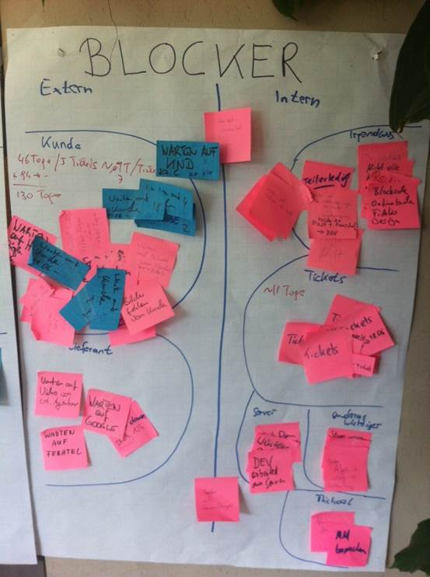
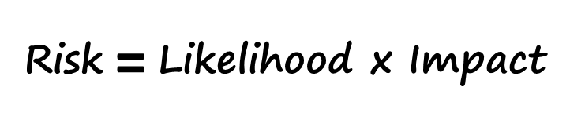
Blocker Analysis
Collect blockers for a time period
Do affinity mapping by reason for blockage
Calculate risk using:
Attack highest risk category first to have biggest impact
Notes:
Blocker analysis allows us to identify the highest risk for the team
Example, if this month we have 100 blockers. 20 blockers, which is 20%, are from customer delay. In average, those blockers add 10 days of delay to their work items. Then Risk (Customer delay) = 20% * 10 days = 2 days.
This means that, in average, all the items are delayed by two days, because of this type of blocker.
We can use this statistic to have a conversation with customer or bring it to the team to discuss on how to improve the team
http://www.djaa.com/project-management-kanban-part-4-risk-review

Slide 110
Blocker Analysis
Cause (Waiting for) | Likelihood (% of blockers) | Impact (Average delay by this cause) | Risk (Days)
Customers | 30% | 10 | 3
System Outage | 15% | 8 | 1.2
Database admin | 5% | 25 | 1.25
Vendor | 40% | 5 | 2
Etc. | 10% | 6 | 0.6
Notes:
Example for blocker analysis
30% means 30% of blockers for closed items this month are from customers
Impact = 10 days means in average, it takes 10 days to remove those blockers
Risk = 3 days means, in average, 3 days of delay were added to every single items we delivered this month

Slide 111
Velocity in projects
Velocity = Total Story Points that the team actually deliver in one metrics period
Velocity may fluctuate over time
Release 1
5
3
5
1
2
8
13
5
8
3
2
1
5
3
8
Period 1
Team velocity for period 1 = 13 SP/ period
Notes:
Key point: We only count completed Items.

Slide 112
Forecasting
Team velocity = 13 SP/ Period
Release 1
72 SPs
1
2
8
13
5
8
3
2
1
5
3
8
5
3
5
Period 1
Period 2
Period 3
Period 4
Period 5
Jan
Feb
Mar
Apr
May
Jun
# of sprints in the release * velocity = story points that we can do per release
E.g., 5 * 12 = 60 story points in release 1
Notes:
Once we have an estimate of velocity we can start to forecast. Some things might no longer fit in the release.

Slide 113
Ongoing Forecasting
High
Low
Notes:
Take the high and low velocities to do ongoing forecasting

Slide 114
Ongoing Forecasting
Product
Backlog
Will Have
Low Velocity x Number of Periods
Release Plan
Might Have
High Velocity x Number of Periods
Won’t Have
Notes:
Multiple the high and low velocity by the number of remain sprints to get lines in the product backlog telling us what we will get, might get, and won’t get based off of history.

Slide 115
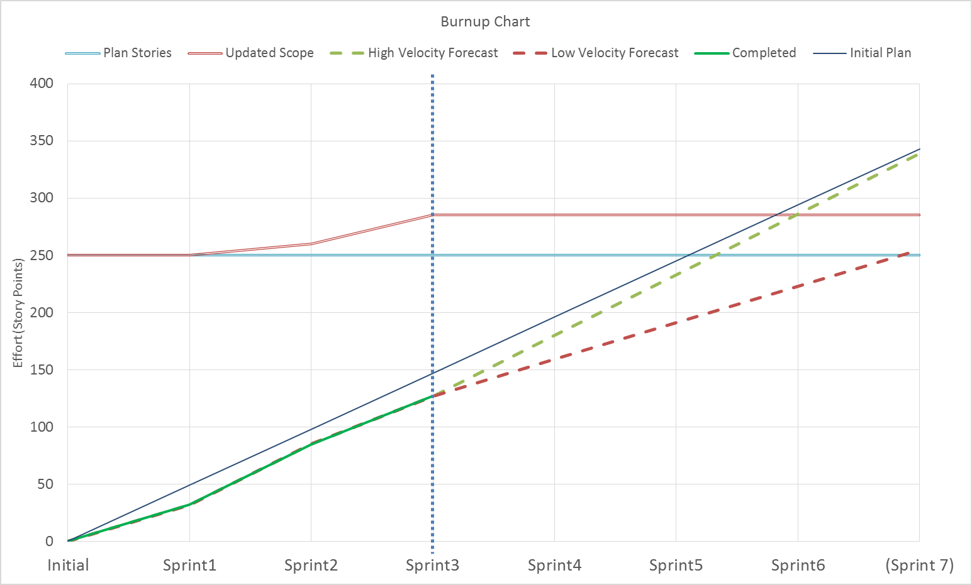
Release Burnup
Notes:
http://ishareteam2.na.xom.com/sites/ASC/ASC%20Public%20Documents/Release%20Plan%20Burn-up%20Chart%20-%20Example.xlsx

Slide 116
Kanban Practices
Kanban Practices
Visualize Workflow
Limit Work-in-progress
Manage flow
Make policies explicit
Improve Collaboratively Explore
Experimentally
Implement feedback loop

Slide 117

Improve Collaboratively Explore Experimentally
2. Set where you want to be
1. Understand where you are
3. Plan and execute
Notes:
<1> In the previous practice, we use metrics to understand where you are
Next is for the team to set the improvement goal <2> (Kanban principles) e.g., we want to reduce the average lead time from 32 days to 28 days
Then the team discusses and come with the improvement idea, through the meeting called retrospective.

Slide 118
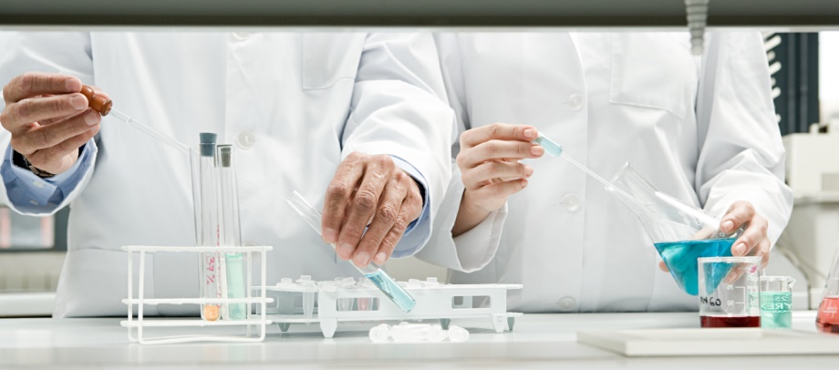
Improve Collaboratively Explore Experimentally
Treat improvement ideas as experiment
Use metrics to measure if the ideas work
Notes:
Objective:
Out of retrospective meeting, we may end up having a couple ideas. (E.g., change the collaboration process with customer, add more detail in the documentation, add a new column to the board, adjusting WIP limit)
Just try it out, and see if it works or not by looking at the metrics. If it works, keep it, otherwise, brainstorm for a new idea. Keep improving

Slide 119
Retrospective meeting
Define Metric Period
Notes:
At the end of each metric period, the team should have a retrospective meeting

Slide 120

Retrospective
Monthly meeting for the team to do lesson learn from their experience
Safe environment for the team
Team members’ voices should be heard equally
Notes:
Learn – Help the team to learn the current situation
Share feedback – Allow team members to share the feedback, both positive (what went well) & negative (what we can improve)
Understand – Walk through each feedback and understand what they mean by those
Vote – We cannot solve all the problems at the same time. Pick the top ones to start with. Voting should not be influenced by other team members
Improve – Brainstorm, how to improve it

Slide 121


Retrospective
What went well
What we can improve
…
…
Learn
Share Feedback
Understand
Vote
Improve
Notes:
Learn
The team comes together and review team status
How much we got done vs. how much we plan
Burndown chart – How does it look like
Share feedback
Each individual writes down what they think it went well & what can be improved on different color post-it notes
Use one post-it note per one comment
After that, put them on the wall
Understand
Facilitator walkthrough each item and ensure that everyone understands what it means
Vote
We cannot solve all the problems at the same time.
Each team member individually vote for the top three on [What we can improve]
Improve
For the top three items of the team, the team brainstorm and create action items to improve it
Learn – Help the team to learn the current situation
Share feedback – Allow team members to share the feedback, both positive (what went well) & negative (what we can improve)
Understand – Walk through each feedback and understand what they mean by those
Vote – We cannot solve all the problems at the same time. Pick the top ones to start with. Voting should not be influenced by other team members
Improve – Brainstorm, how to improve it

Slide 122
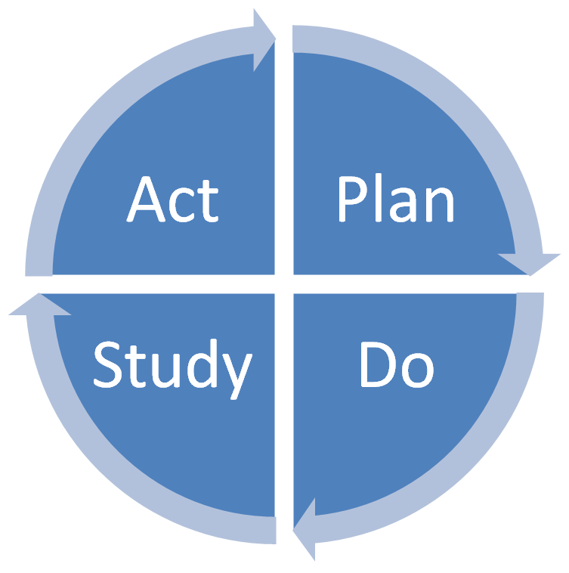
Continuous Improvement in Kanban - PDSA
Review Metrics &
Retrospective
Validate assumptions
experimentally
Run metrics
Take action
Notes:
We look at the metrics and see where we can improve. Brainstorm for ideas to come up with action items
Take that action. It could be a simple board change, WIP limit updates or process change like documentation template, etc.
After a few months, run those metrics again. See if we see any improvements
Validate assumptions if those action items bring us to where we want to be (E.g., reducing WIP for this column should reduce our lead time while remaining our throughput). If it is working, keep the change and find another area of improvements, if not, it is just an experiment. We know that it is not working and just try something new

Slide 123
Demos
Have a cadence for demos
First chance for stakeholders to give feedback
Notes:
[Project Slide]

Slide 124
Critical Practices in a Kanban Team
Regularly run metrics to measure team’s performance & find areas of improvement
Set metric period
Share metrics with team members
Build sense of ownership with the team
Set goals as a team
Have a retrospective meeting regularly
Improve team’s process continuously
Everyone is responsible to improve the workflow

Slide 125
Summary

Slide 126
Common problems in teams
Transparency
End-to-end visualization
Priority
Prioritization
Collaboration
Pull concept
Focus
WIP Limit
Blockers
Agile Team
Share view with business
Improvement
Visualize bottlenecks
Metrics
Retrospective
Stand up meeting
Pull concept
Manage flow
Notes:
Summary: We solve transparency problem by visualizing our work on a Kanban board
We are aligned on priority by prioritization, right-to-left priority & stand-up meeting
We increase collaboration through having an Agile team, give team’s autonomy through pull concept, create a blocker and get help from each other
We improve focus by controlling a number of item in WIP by using pull concept & WIP limit
Lastly, we improve our process through Retrospective and use metrics to validate our assumption

Slide 127
3 ways to control Work in Progress (WIP)
Pull system
WIP
limits
Right to left
Analyst should start new work only when they have cycles
Limit the number of work items that can be in each column
Stop starting & start finishing
Notes:
3 ways to reduce WIP

Slide 128
Kanban Evolution
Visualization
Collaboration
Commitment
Prioritization
Efficiency
Evolution
Kanban Framework
Kanban Board
Notes:
Objective: Kanban is NOT about visualization. It is about continuous improvement
Benefits = where you set the goal. If you set the goal at prioritization, that is what you get.
Implementing Kanban board gives us these benefits
Visualization
Discover information those are hardly seen (bottle necks, aged items, workload)
Align team’s understanding
Prioritization
Make sure that team always deliver the highest value items from customer perspective
Most of the team those applied Kanban always earn these benefits. However, if we step beyond just a Kanban board, but Kanban framework, then we get even more benefits.
Collaboration
Visualized blockers help people to break silos and help each other to get things done
Efficiency
WIP limit helps the team to focus on a fewer number of items and get it done faster with less efficiency loss due to multi-tasking
Pull concept also helps on focus
Commitment
Metrics & goals drive commitment to the team, changing mindset from task-oriented to result / value oriented
Evolution
The team agrees to improve and evolve

Slide 129
Kanban Practices
Kanban Practices
Visualize Workflow
Limit Work-in-progress
Manage flow
Make policies explicit
Improve Collaboratively Explore
Experimentally
Implement feedback loop

Slide 130
Summary – Kanban Practices
Kanban is a work management framework that drives the team toward incremental evolutionary change
Kanban board is just a tool to help achieve the goal
Everything has to be visualized on Kanban board
Tickets, initiatives, project work, SWIs
This allows us to see the real WIP
Control your WIP – Higher WIP = Longer lead time
Pull instead of Push
Respect WIP limits

Slide 131
Summary – Kanban Practices
Make sure that everyone is working on the right priority
Class of service, right-to-left, top-to-bottom
Search for bottlenecks and start improvements
Use metrics to assess the current situation
Do retrospective to gather improvement ideas
Run metrics again to evaluate the result

Slide 132


http://goto/agileyammer
http://goto/joinagilecop

Slide 134
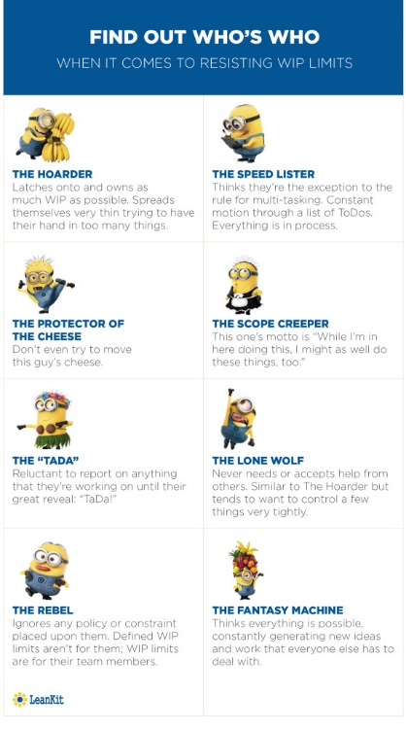
Which one are you?

